Slide 1
Egad! It’s Excel
Day 2
The Data Bootcamp

Slide 2
Admin Stuff

Slide 3
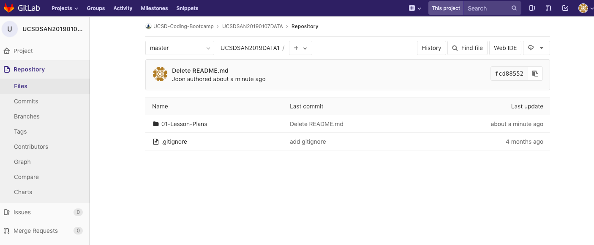
Class Git Repository
All Class Content and Homework will be here:
https://ucsd.bootcampcontent.com/UCSD-Coding-Bootcamp/UCSDSAN2019DATA1/tree/master

Slide 4
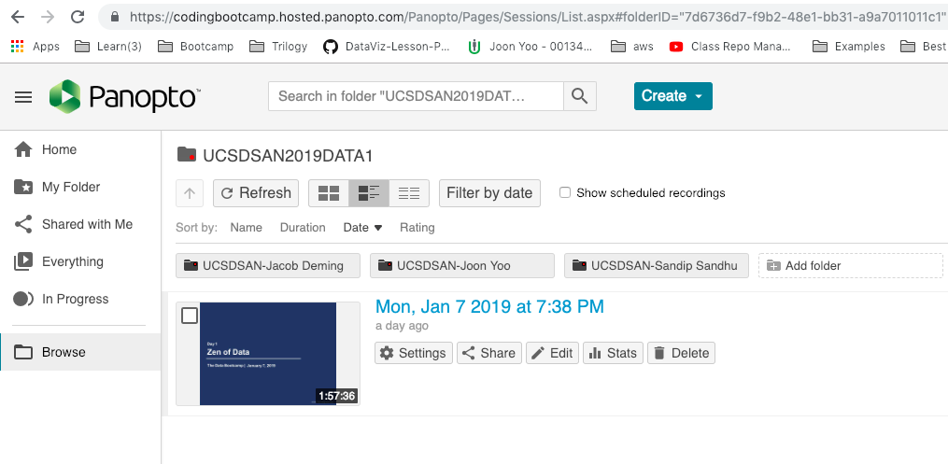
Class Videos
Class Videos will be automatically uploaded here:
https://codingbootcamp.hosted.panopto.com/Panopto/Pages/Sessions/List.aspx#folderID=%227d6736d7-f9b2-48e1-bb31-a9a7011011c1%22

Slide 5
Homework Assignment #1
You will be analyzing thousands of Kickstarter projects to look for funding trends across goal targets and topics.

Slide 6
Homework Assignment #1
Due: Next Saturday
Recommended Target: Thursday of Next Week

Slide 7
Quick Refresher

Slide 8
Data Science is about what two things?

Slide 9
Truth-Telling & Story Telling

Slide 10
What are the steps in the Analytics Paradigm?

Slide 11
Analytics Paradigm
Decompose the Ask
Identify Data Sources
Define Strategy and Metrics
Build Data Retrieval Plan
Retrieve the Data
Assemble and Clean
Analyze for Trends
Acknowledge Limitations
Make the Call or
Tell the Story
Regardless of type or industry, this paradigm provides a repeatable pathway for effective data problem solving.

Slide 12
Let’s Start with the Basics

Slide 13
Formulas

Slide 14
Ooh… Coding! (Sort Of)
Function
=
SUM(
1, 2, 3
)
Arguments
In a way, Excel has introduced you to a sort of proto-programming. Throughout your time writing scripts you will rely on functions (methods) that do something to or with arguments.

Slide 15
Ooh… Coding! (Sort Of)
Function
=
AVG(
F4:F6
)
Variable Arguments
When we reference a set of range, Excel is being given a set of variable inputs. It will determine the actual values of these inputs prior to executing the function.

Slide 16
Ooh… Coding! (Sort Of)
What about this example?
Which is the function? Which are the arguments?
= SUM( AVG(F4:F6), AVG(G4:G6) )

Slide 17
Ooh… Coding! (Sort Of)
What about this example?
Which is the function? Which are the arguments?
= SUM( AVG(F4:F6), AVG(G4:G6) )
It Depends…

Slide 18
Ooh… Coding! (Sort Of)
What about this example?
Which is the function? Which are the arguments?
= SUM( AVG(F4:F6), AVG(G4:G6) )
The AVG functions takes as their arguments the ranges provided.

Slide 19
Ooh… Coding! (Sort Of)
What about this example?
Which is the function? Which are the arguments?
= SUM( AVG(F4:F6), AVG(G4:G6) )
This is a nested function. We’ll be doing plenty of complex nests in this class.

Slide 20

You Can Code Too!
Python Snippet

Slide 21
You Can Code Too!
Python Snippet
Another Function
(Chained)
Function
Arguments
Syntax and capabilities may differ across technologies and platforms, but fundamental concepts remain the same.

Slide 22
Demo Time! (01-ExcelPlayground, 02-NamedRanges)

Slide 23
Conditionals

Slide 24
Conditionals: If This… Then That
Step 2a
If criteria is met…
Step 1
If criteria is not met…
Step 2b
Conditionals present a way to control the flow of logic based on certain criteria being met. This is a core building block in all languages.

Slide 25
Conditionals: If This… Then That
Set Cell to True
If D2 > 5
Determine D2’s Value
If D2 <=5
Set Cell to False
=IF(D2>5,TRUE,FALSE)

Slide 26
But what if… we wanted to combine conditions?

Slide 27
AND, NOT, OR

Slide 28
Condition 1 AND Condition 2
Both Conditions Must be True

Slide 29

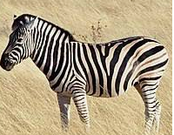
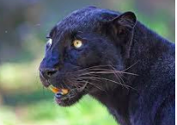
Condition 1
Condition 1: Black Fur

Slide 30
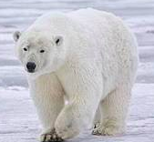
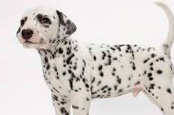

Condition 2
Condition 2: White fur

Slide 31
Condition 1 AND Condition 2
Condition 1: Black fur
Condition 2: White fur
Both Conditions Must be True

Slide 32
Condition 1 OR Condition 2
Condition 1: Black fur
Condition 2: White fur
Either Condition can be True

Slide 33
Condition 1 OR Condition 2
Condition 1: White fur
Condition 2: White fur
Either Condition can be True

Slide 34
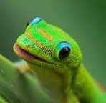
Condition 1 OR Condition 2
Condition 1: White fur
Condition 2: White fur
Either Condition can be True

Slide 35
Conditionals: If This… Then That
=IF(AND(D2>5, D2<10),TRUE,FALSE)

Slide 36
AND(D2>5, D2<10)
Condition 1: D2>5
Condition 2: D2<10
6
7
8
9
10
11
12…
1
2
3
5
Both Conditions Must be True

Slide 37
Conditionals: If This… Then That
Set Cell to True
If D2 > 5 AND D2 < 10
Determine D2’s Value
If D2 <=5 OR D2 >= 10
Set Cell to False
Nesting conditionals can quickly become a very convoluted (albeit necessary) part of your data prep.

Slide 38
Demo Time! (03-ColorCounter – 08-McDonalds)

Slide 39
BREAK

Slide 40
Pivot Tables

Slide 41
Get Pivot With It
Pivot Tables are one of the most important data visualization concepts to master in this class.
(Don’t worry. They are a cinch to deal with)

Slide 42
Get Pivot With It
Seller | Qty. Sold | Date
Joseph | $42.50 | 1/1/17
Jacob | $65.00 | 1/3/17
Jacob | $5.25 | 1/6/17
Joseph | $125.00 | 1/6/17
Jacob | $3.50 | 1/7/17
Matt | $32.00 | 1/9/17
Seller | Total Sold
Joseph | $167.50
Jacob | $73.75
Matt | $32.0
In essence, Pivot tables are a summative analytic tool that allows us to perform aggregate functions that along any combination of fields.
(The name comes from the fact that we are pivoting along a data axis)

Slide 43

Words to the Wise – Keep It Flat!
Modern BI tools like Tableau, Sisense, and Salesforce work best if data is stored in flat CSVs – meaning column headers represent fields (vertically) on the spreadsheet. This is largely because all of these technologies heavily utilize Pivot Tables beneath their visualizations.
Don’t try to confuse this simplicity. “Spreadsheet magic” is a nightmare to analyze.

Slide 44
Demo Time! (09-PivotTables, 10-TopSongs)

Slide 45
Lookups

Slide 46
Look It Up with Lookups
Planet | Population
Zeelo | 5020
Merinoa | 380
Cardboard Box | 2
… | …
Asteroid 9 | 95
Assume this table is gigantic…
How would we retrieve the population of a specific planet for use in another formula?

Slide 47
Look It Up with Lookups
Planet | Population
Zeelo | 5020
Merinoa | 380
Cardboard Box | 2
… | …
Asteroid 9 | 95
Assume this table is gigantic…
How would we retrieve the population of a specific planet for use in another formula?
=vlookup( <value>, <full table>, <column to retrieve>,<match parameter>)

Slide 48
What Will This Yield?
Planets
Planet | Population | Species
Zeelo | 5020 | Zoltans
Merinoa | 380 | Murphies
Cardboard Box | 2 | Hambones
… | …
Asteroid 9 | 95 | The Asterisks
=vlookup( “Asteroid 9”, Planets, 3, FALSE)

Slide 49
What Will This Yield?
Planets
Planet | Population | Species
Zeelo | 5020 | Zoltans
Merinoa | 380 | Murphies
Cardboard Box | 2 | Hambones
… | …
Asteroid 9 | 95 | The Asterisks
=vlookup( “Asteroid 9”, Planets, 3, FALSE)
The Asterisks

Slide 50
Demo Time! (11-Lookups, 12-ProductPivot)

Slide 51
Questions / Discussion
Notes:
It’s important to keep in mind why you joined this class. Let’s talk about your goals.

